Slide 1
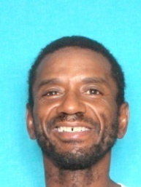
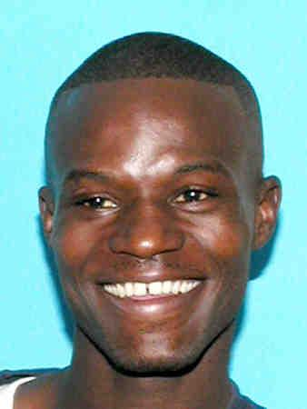
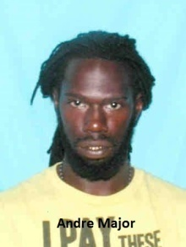
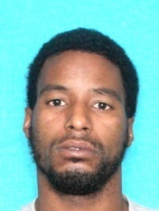
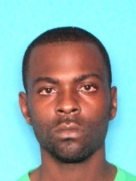
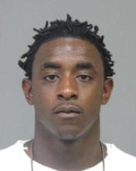
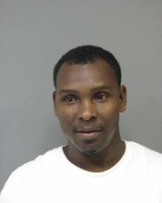

Alvin Duplessis Dist. Crack
Jermaine Mitchell Dist. Crack
Jermone Frederick Dist. Crack
Andre Major Dist. Crack
Tevin Harrison Dist. Crack
Damien Landry Dist. Crack
David Johnson Dist. Crack
Ikeria Narcisse Dist. Crack

Slide 2
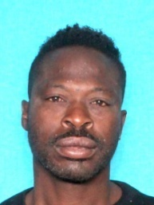
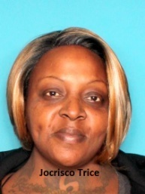
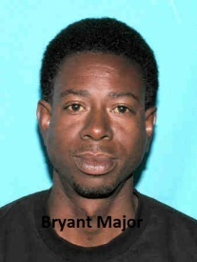
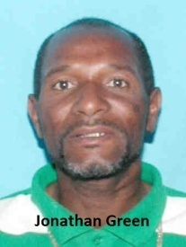
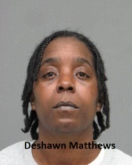
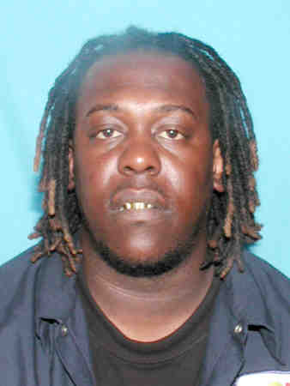
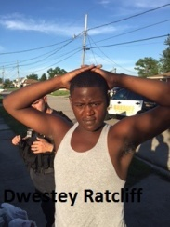
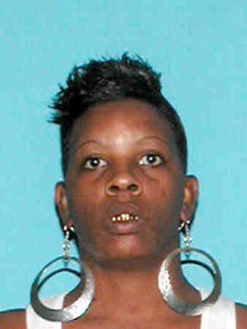
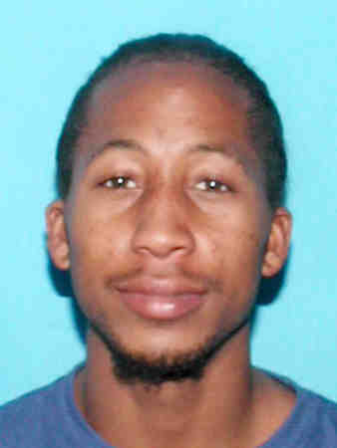
Arrested subjects
Allen Jones Alvin Duplessis
Jocrisco Trice Dist. Crack
Bryant Major Dist. Sch. II
Jonathan Green Dist. Heroin
Deshawn Matthews Dist. Crack
Kevin Turner Poss. Marijuana
Dwestley Ratcliff Dist. Crack
Melody Lafrance Dist. Crack
Jason Blaise Dist. Crack

Slide 3
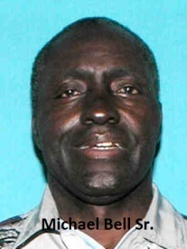
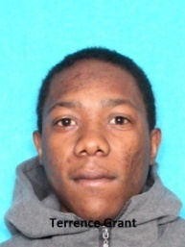
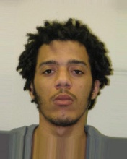
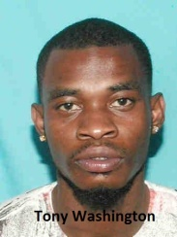
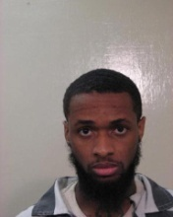
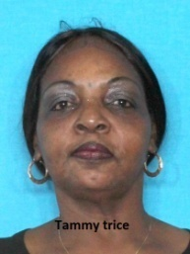
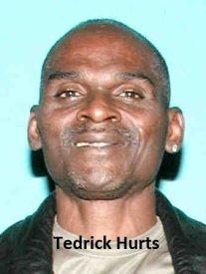
Michael Bell Dist. Crack
Terrence Grant Dist. Heroin
Ronald Jones Dist. Crack
Tony Washington Dist. Crack
Shawn Smith Warrant JPSO
Tammy Trice Dist. Crack
Tedrick Hurts Dist. Crack

